Slide 1
XLNet
Zili Wang & Canjia Li

Slide 2
背景
one-hot, word2vec, fasttext, lstm
ELMO:
通过用RNN训练双向语言模型得到单词的Word Embedding
GPT
以语言模型作为目标任务，但是采用的是单向的语言模型(Transformer)
Bert的局限性
独立性假设：输入的[MASK]之间是独立的
输入噪音：依赖[MASK]标记识别需要预测的位置。输入输出不一致。

Slide 3
Auto-regressive vs Auto-decoding
Auto-regressive: 上文无法看到下文
代表模型：ELMO，GPT
Auto-decoding：重建出输入
代表模型：BERT
Word2vec该属于哪一种？

Slide 4
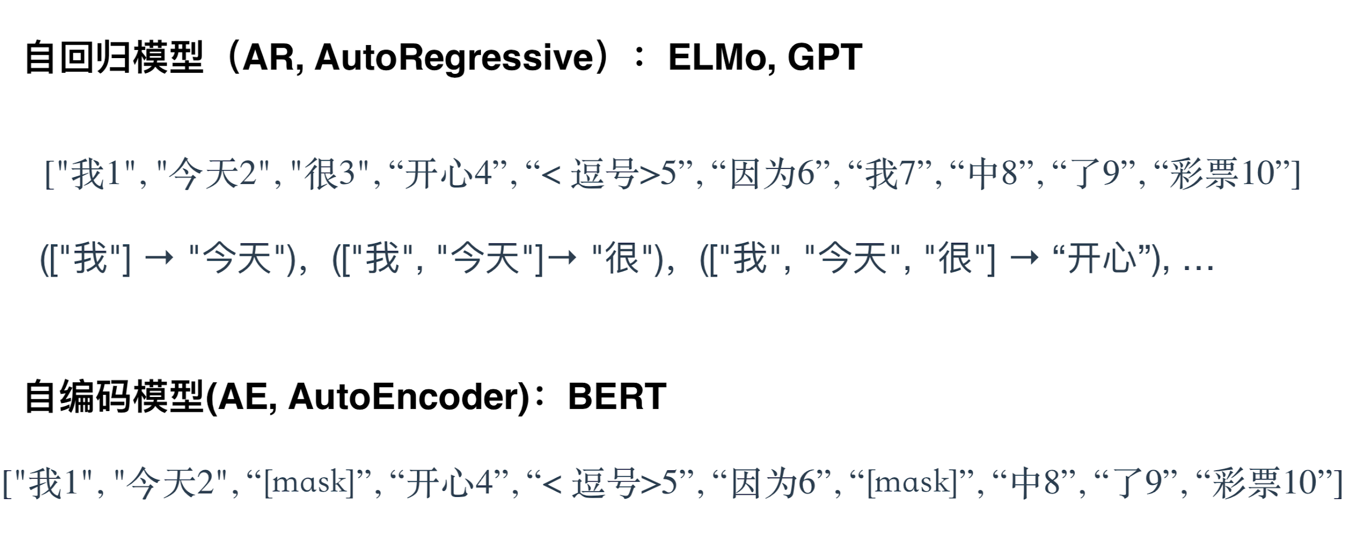

Slide 5
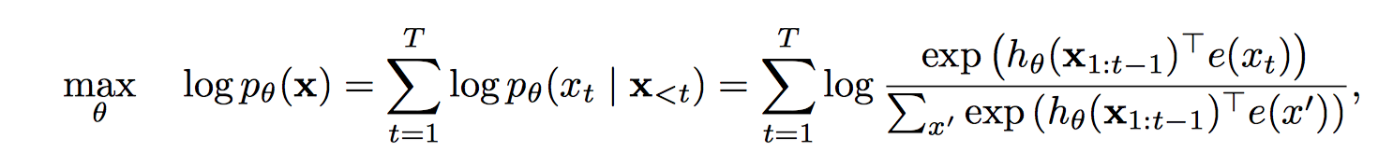
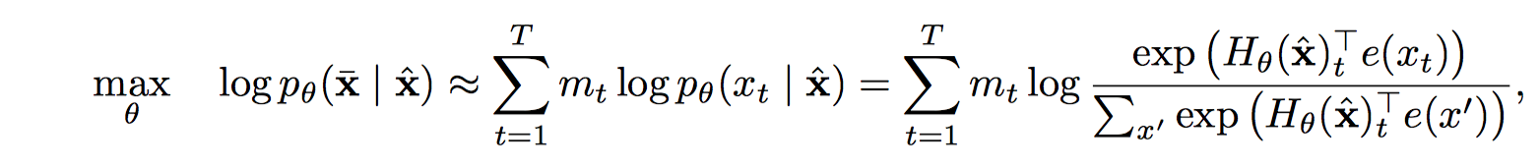
Auto-regressive
Auto-decoding
Input noise for downstream task
Based on an independence assumption
Context dependency
A natural question to ask is whether there exists a pretraining objective that brings the advantages of both while avoiding their weaknesses

Slide 6
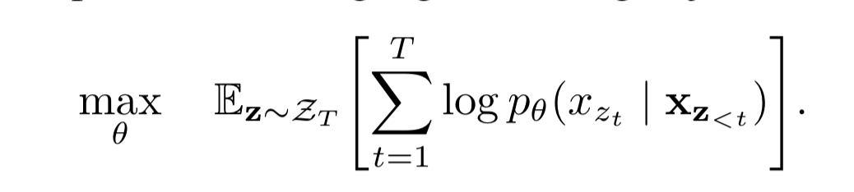
Permutation Language Model
Objective: retains the beneﬁts of AR models & allows models to capture bidirectional contexts
For a sequence x of length T, there are T! different orders to perform a valid autoregressive factorization.

Slide 7
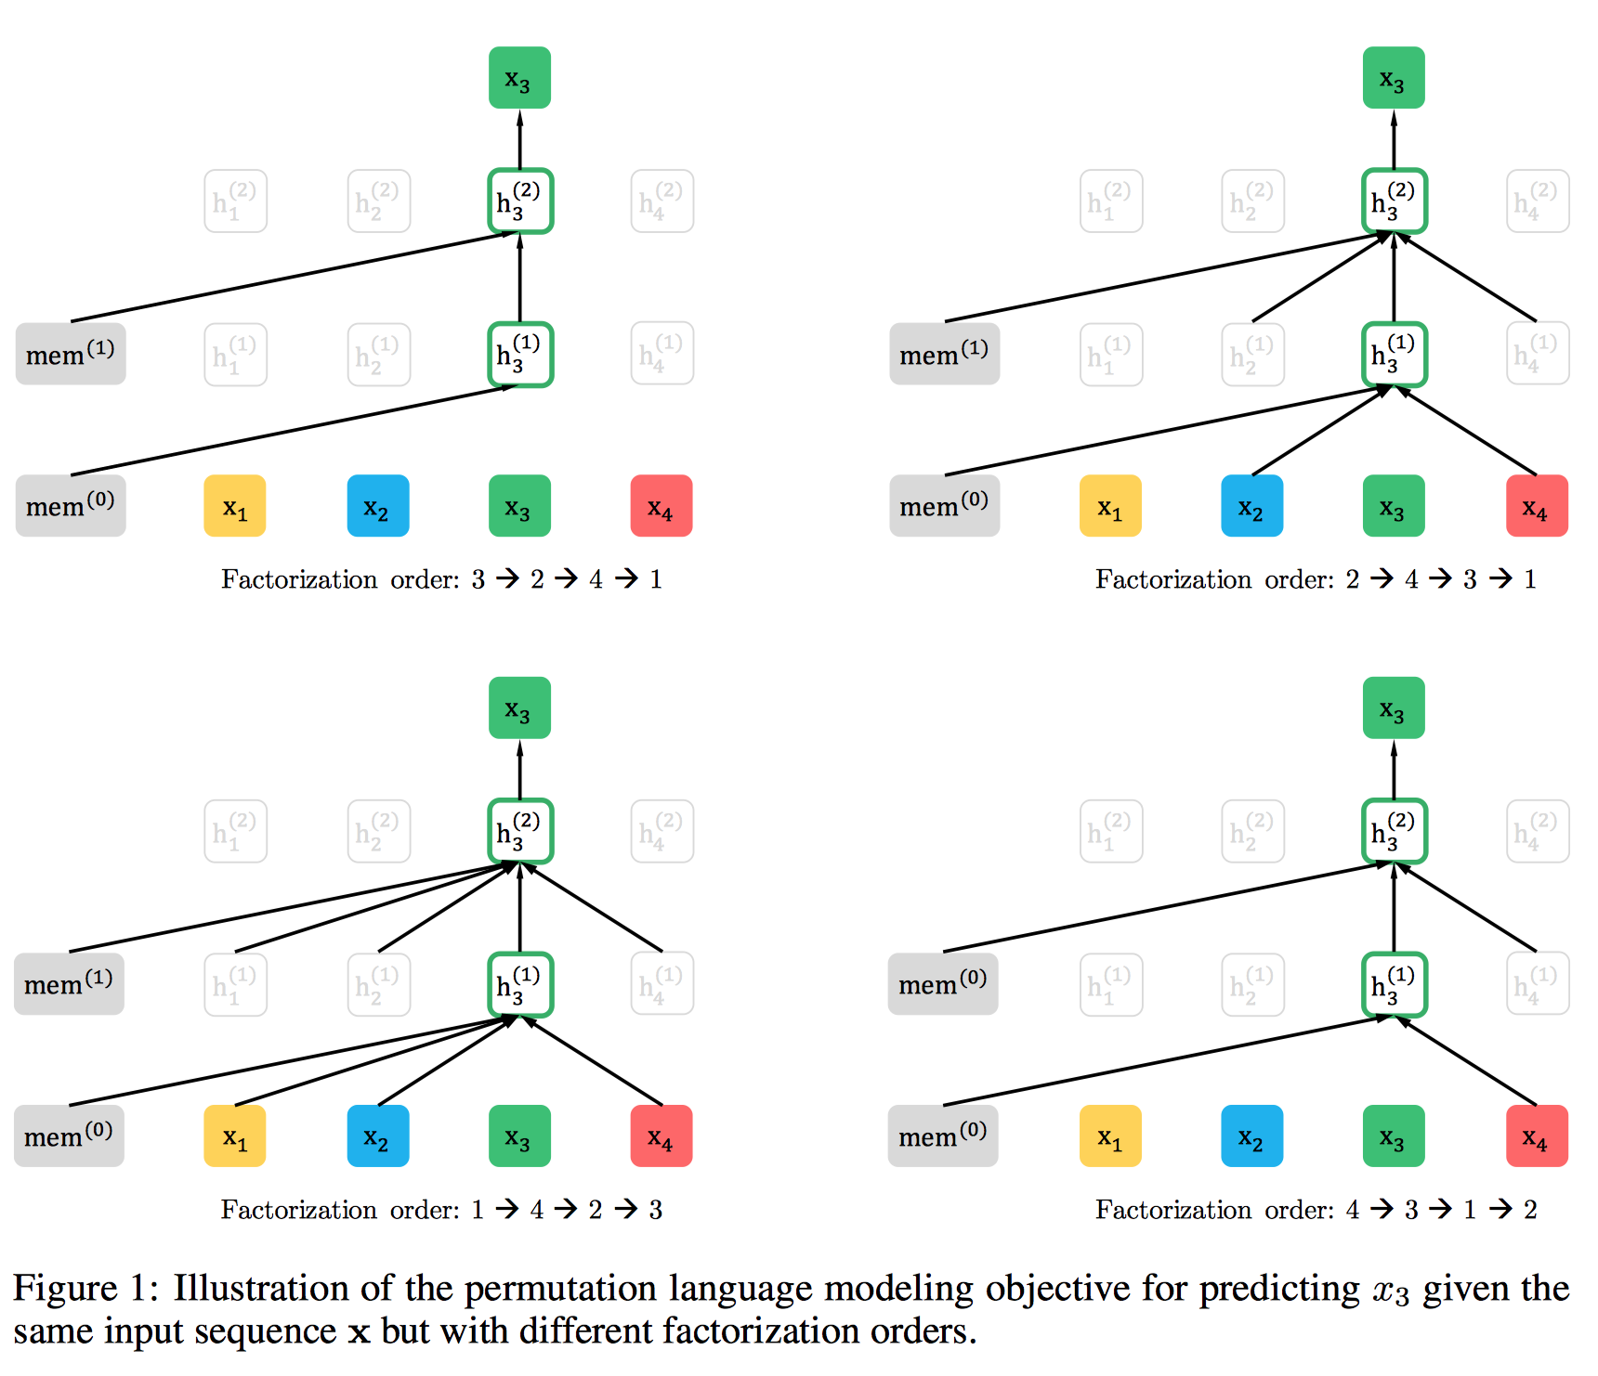
Permutation Language Model
The example of predicting the token x3 given the same input sequence x but under different factorization orders
Attention Mask

Slide 8
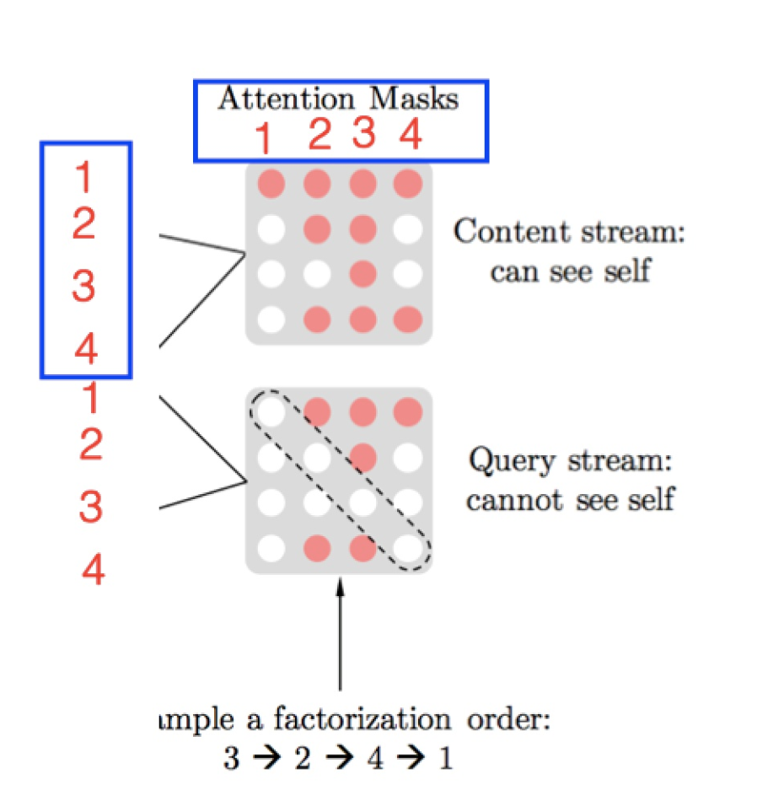
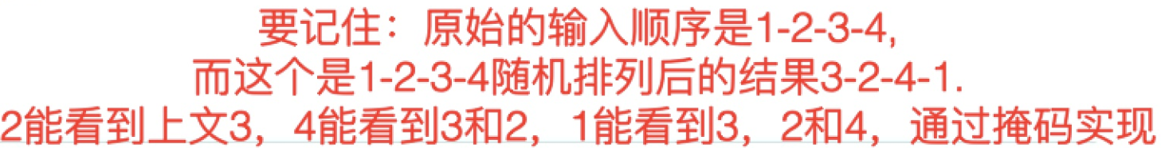
Attention Mask

Slide 9
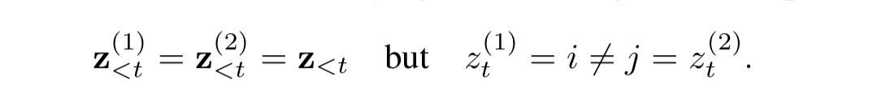
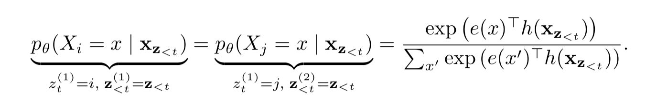
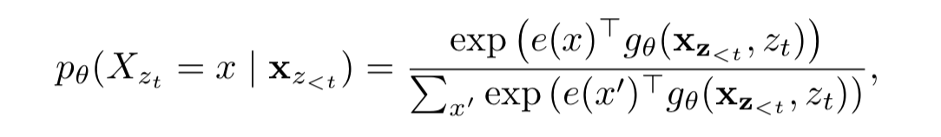
Two-Stream Self-Attention

Slide 10
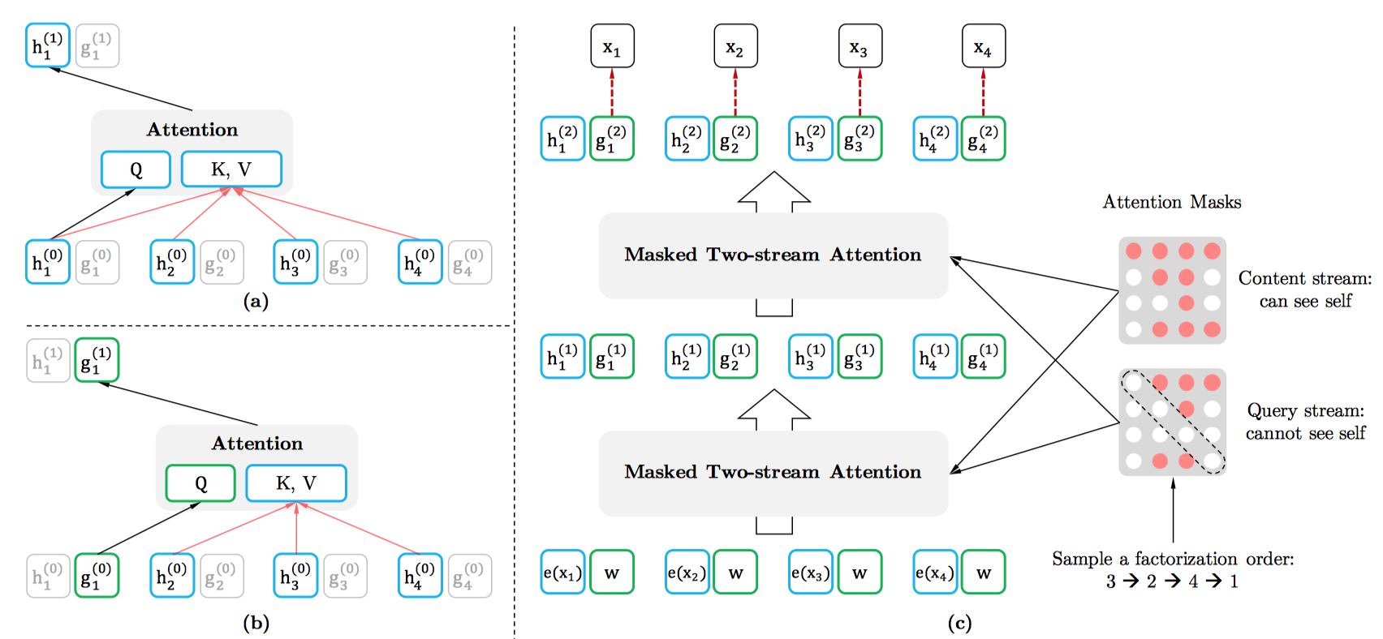
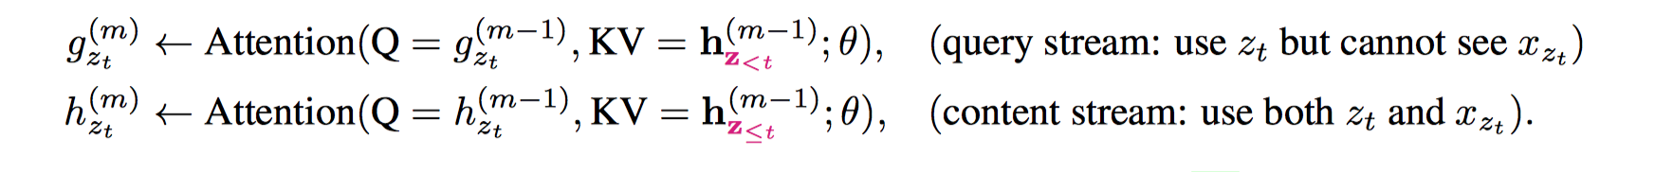
Two-Stream Self-Attention

Slide 11
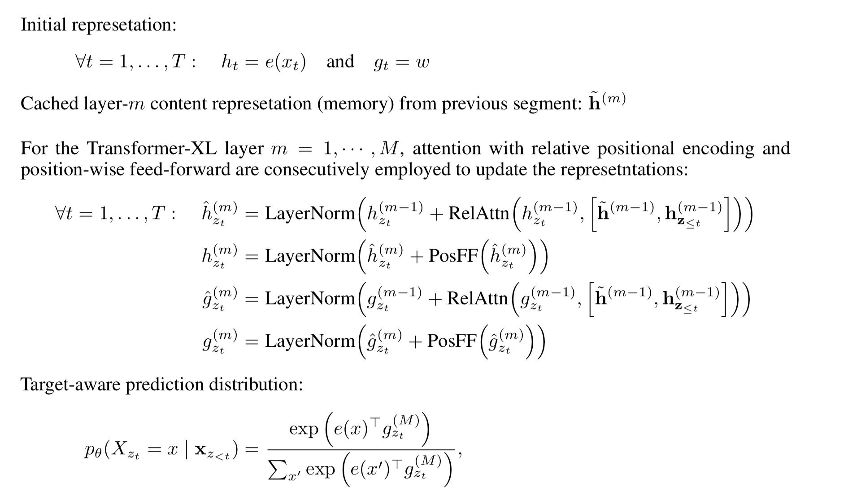
Two-Stream Self-Attention

Slide 12
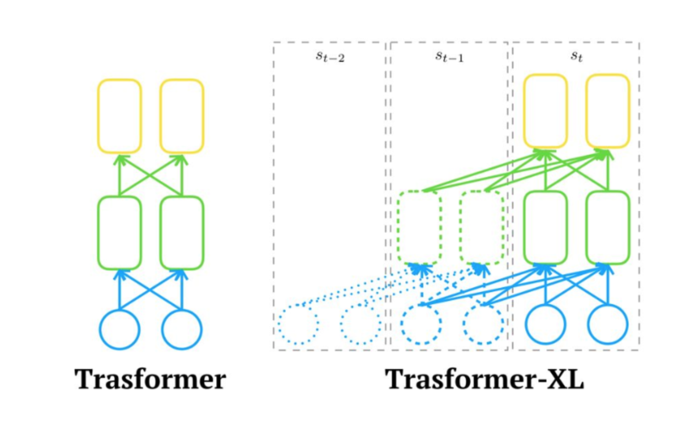
Transformer-XL
Query 是当前segment的上一层的输出
Key/Value是当前segment当前层的Key/Value拼接上一个segment的self-attention之后的输出

Slide 13
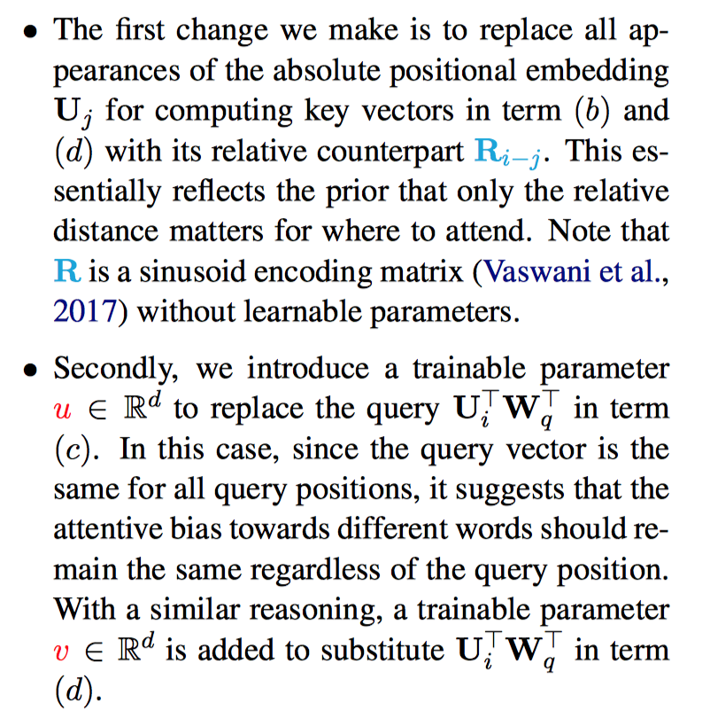
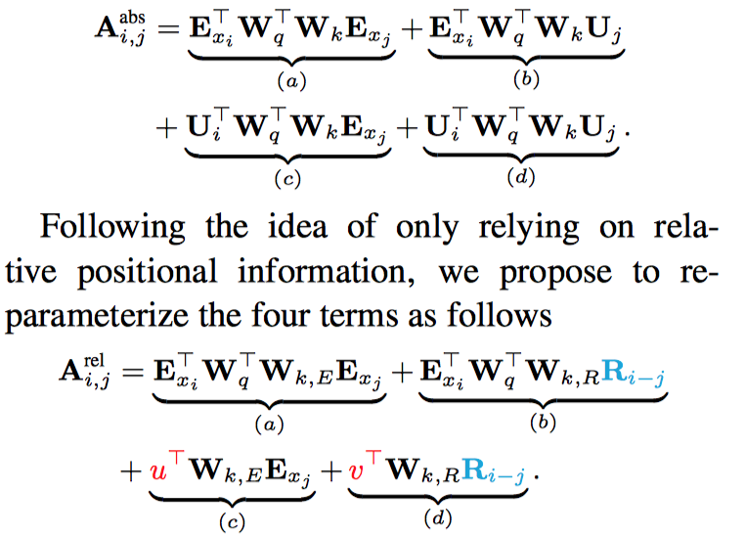
相对位置编码
Previously, A = E + U

Slide 14
Transformer vs Transformer-XL
Transformer
fixed length
长文本被切分成不同的片段之后，片段之间是没有联系的
Transformer-XL
recurrent structure, like RNN
Query不变，改进在于Key，Value，通过将上一个片段的表示拼接到当前片段的Key，Value表示。 与Transofrmer encoder-decoder的比较：encoder最后一层的输出是Key，Value表示，Query来自于decoder上一层的输出
absolute PE to relative PE （PE: Position Embedding)
Motivation: 上个片段跟下个片段是属于同一个文本，如果用相对位置编码，片段之间的位置信息就不一样了
做法：做attention的时候使用相对位置编码。

Slide 15
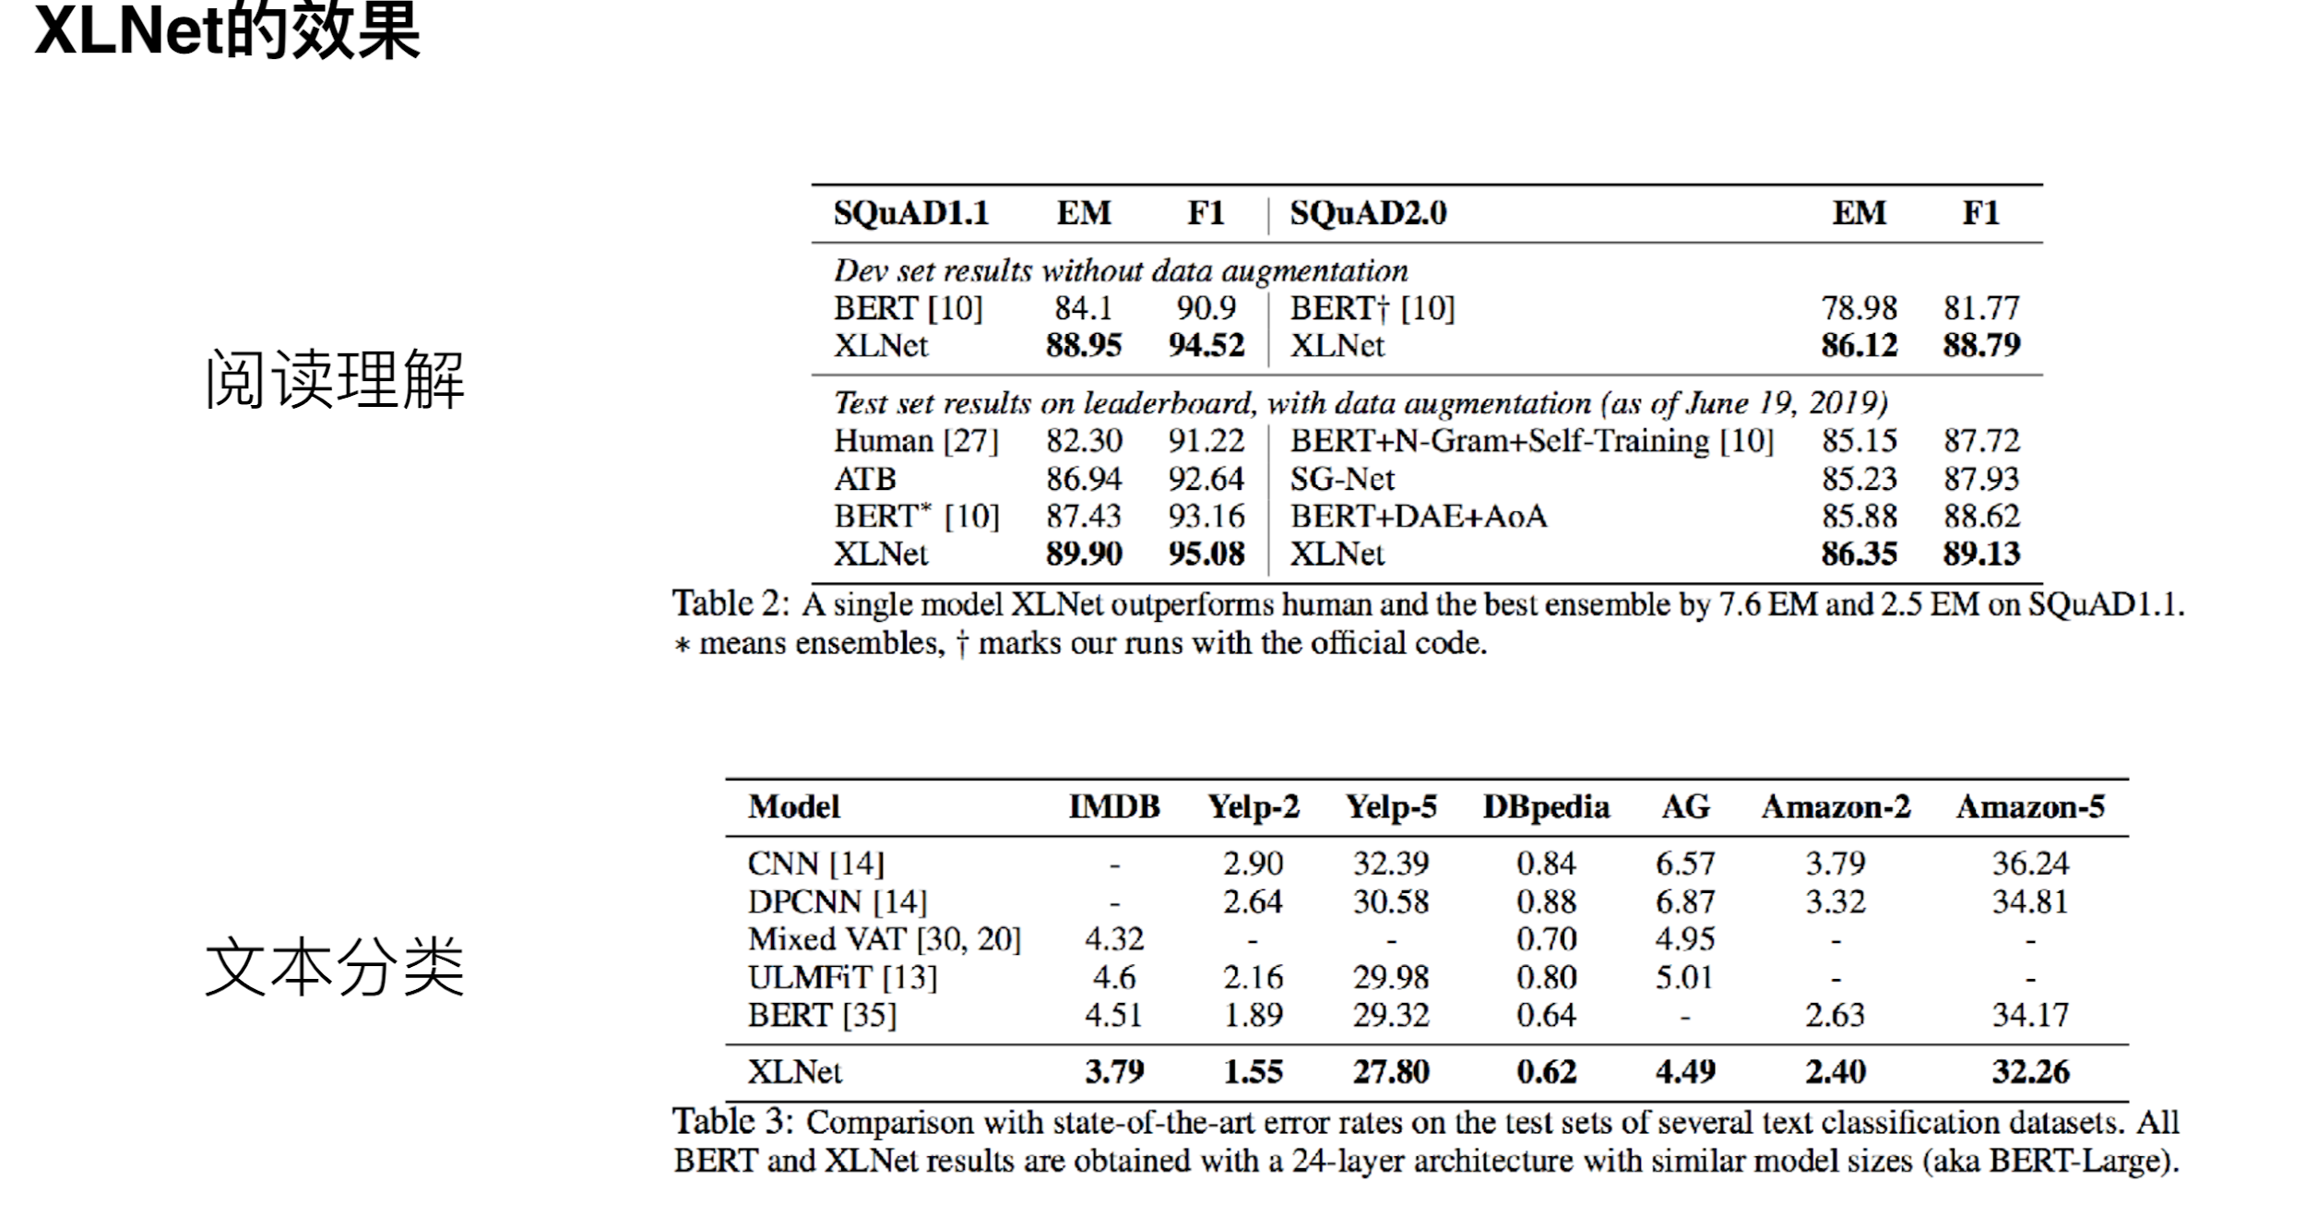

Slide 16
